Slide 1


Slide 2

Git Fundamentals
Welcome!
Gavin Ray
Instructor, Pluralsight
Notes:
Mandatory
ACTION: Adjust title to fit your course.

Slide 3

Gavin Ray (he/him)
About Me:
Instructor at Hello World CS
Data Science and AI tutor with Wyzant
Software Engineer, WGU
Galvanize DS/AI bootcamp graduate
Father of one amazing 5yo boy
Notes:
Mandatory
ACTION: Adjust to fit you.
Script: I am [insert name] with DevelopIntelligence. We’re the training partner for [insert client name]. [Provide brief info on your background.]
Wing it!!! Keep it short!!! (Under 2 minutes; less than 1 is even better). Your goal is to establish rapport. You’re just trying to connect with the students. For example...
Here’s a little about my background in case you want this for reference later. Fun fact: [insert a piece of trivia about your personal life…”When I’m not teaching or coding, I am a skydiver”…whatever cool hobby you are engaged in]
Avoid putting your resume here. Say only a sentence or two about your professional credentials and invite them to ask questions about your background or experiences at any point during the training.

Slide 4
Prerequisites
This course assumes you
Have used a command line interface before
Have installed Git version 2.25 or above
Have a simple text editor or IDE
Have a Github.com account
Please note:
If you have never programmed before or need help with the above, let me know right away and we can work through it together.
Notes:
Mandatory
ACTION: Adjust prerequisites to fit your course. Keep it brief.
Script: Before we start, I want to make sure everyone is in the correct class. Take a look at these prerequisites and message me in Chat if you have questions or aren’t sure you’re in the right spot.

Slide 5
Why study this subject?
To master the industry standard in version control
To enhance team collaboration
To minimize errors and simplify code recovery
To boost productivity in software development
To enable efficient distributed and remote work
To access a free and open-source tool
To handle projects of any size
To elevate code quality and the code review process
Notes:
Mandatory
ACTION: Adjust benefits to fit your course.
Examples...
You’ll be learning Python so that you can work on XYZ project…

Slide 6








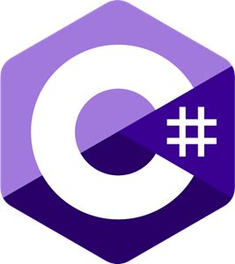





























We teach over 400 technology topics.
Notes:
Mandatory
Script: Pluralsight teaches a lot of different tech. If there’s a technology you want to learn and you don’t see it in your company’s learning catalog, let your manager know. We’d be glad to help.”

Slide 7



You experience our impact on a daily basis!
Notes:
Mandatory
Script: In your everyday life, you come across tech many times a day. When you shop online. When you pay for your morning coffee. When you watch a movie or travel. We train software developers and IT professionals who work on many of the products and services you use daily.
In fact, when you talk on the phone, watch a movie, connect with friends on social media, drive a car, fly on a plane, shop online, and order a latte with your mobile app, you are experiencing the impact of our solutions.

Slide 8
My pledge to you:
I will..
Make this course interactive
Ask you questions
Ensure everyone can speak
Create an inclusive learning environment
Use an on-screen timer for breaks
…also, if you have an accessibility need, please let me know!
Notes:
Mandatory
Script: This is my pledge to you. I’d like to talk in particular about the third bullet. Sometimes in a class, an enthusiastic participant will want to speak out in every discussion, answer every question and so forth. I want to make sure all of you have the opportunity to be heard. So, if I haven’t heard from you in awhile, I may call on you or check in via chat, because I want to make sure everyone gets their questions answered. Also, I want to demonstrate the timer and confirm that everyone can see it. EggTimer is a good timer - https://e.ggtimer.com/

Slide 9
Objectives
At the end of this course, you will be able to:
Explain in your own words about what source control is
Efficiently use the CLI to manage and track code changes
Resolve merge conflicts with confidence
Collaborate effectively with remote teams
Implement Git workflows in real-world scenarios
And so much more!
Notes:
Mandatory
ACTION: Adjust objectives to fit your course.
Use measurable objectives that start with action verbs such as: describe, define, identify, assess, demonstrate, use, utilize. https://elearningindustry.com/writing-learning-objectives-for-elearning-what-elearning-professionals-should-know

Slide 10
History of Git
Broad level understandings / mental maps
Initializing and configuring the Git repo
Managing a codebase with the CLI
Working with remotes, branches, merging, etc
Resolving merge conflicts
Advanced tools if we have time
Notes:
Mandatory
ACTION: Adjust agenda as per your course.
The agenda provides students a roadmap of where the class is going and what is coming up. Keep it high level, as there is no need to include “Gazornin” in the agenda if that’s something they don’t understand. Refer to the agenda at the beginning of the class, at the end of every day and at the beginning of every morning. In the mornings, the Agenda is a great way to facilitate a Q&A session about what was covered on the previous day.

Slide 11
How we’re going to work together
You will be added to the public git repo for this course
It includes a copy of this slide deck
It will be our playground for completing activities
All course activities are outlined in this slide deck
We will be working through the activities together
Notes:
Mandatory
ACTION: Adjust bullets as per your course.
In this section, discuss the structure of the course—exercises, labs, etc.
Also, discuss any resources students will be using.

Slide 12
Student Instructions
Job title?
Where are you based?
What is your related experience, if any?
Fun fact?
Your name?
And preferred pronouns?
Notes:
Optional, because you may already plan to do this in your own materials…
ACTION: We want to be sure you take time to have the students introduce themselves. It could happen here, or it could happen at the start of your materials.

Slide 13
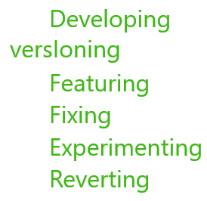
What is Source Control?
How your code will DIFFER through time.

Slide 14


Originated within the Linux Open Source Community
Linus Torvalds: Best known as the creator of Linux. Also made Git as a source control method for the Linux project.
They were using Bitkeeper, but it fell short in some ways:
Centralized
Proprietary
Licensing conflicts

Slide 15
Improvements from switching to Git include…
Distributed code base
Simple design is lightweight
Easy branching and forking
Supports large repositories
Robust staging area
All these requirements came together to form a flexible source control, that is fast and easy to use. It supports individual users and large teams equally. But the most benefit comes from it being distributed. Let's talk more about that next.

Slide 16
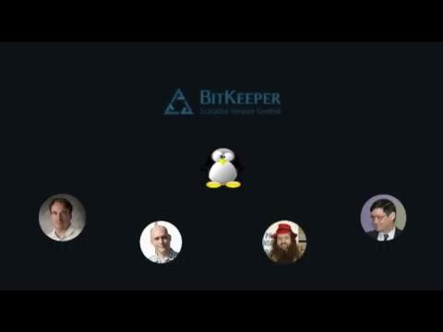
Distributed Vs. Centralized
Centralized:
One main server stores the repository. This forces everyone to pull from one source, leading to bottle necks. Also, if the server goes down or if the programmer loses connection, progress is halted.
In photos: Linus Torvalds, Greg Kroah-Hartman, Alan Cox, and Andrew Morton- all well known Linux developers. Images from Wikipedia.

Slide 17
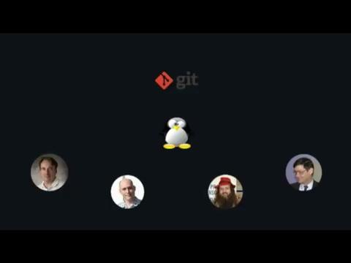
Distributed Vs. Centralized
Decentralized:
The complete repo history exists on everyone's individual computer. A central server can still be used to provide the working version to customers. Developers work in parallel without limitation.
In photos: Linus Torvalds, Greg Kroah-Hartman, Alan Cox, and Andrew Morton- all well known Linux developers. Images from Wikipedia.

Slide 18
Who is using Git?
Everyone.
Programmers and developers, content creators and writers, academics and researchers, web designers, training organizers and educators, project managers, graphic designers, legal professionals…
Git is essential for anyone who needs to store, track, and manage versions of their files.
Github claims 100M+ developers, 90% of Fortune 100 companies, and 4M+ organizations.

Slide 19


Git vs GitHub?
Git operates primarily on the local machine, enabling users to manage their repositories and history of changes independently of any central server.
GitHub is a web-based platform that hosts Git repositories and provides additional collaboration features. It acts as a remote repository where developers can push their local Git repositories, enabling team collaboration, code review, project management, and integration with various other tools. GitHub adds a layer of social networking to software development by facilitating issue tracking, pull requests, and other features that enhance team collaboration.
-ChatGPT

Slide 20
How does Git work?
Local Concepts:
Repo
Stage
Commit
Clone
Branch
Merge
^
Pull
v
Cloud Concepts:
Fork
PR
Upstream
Remote
Push
Fetch

Slide 21
Repo, Stage, Commit
Repo: A repository, or collection, of files. This usually refers to the directory where your files are stored. A Git repo also tracks changes and many other things.
Stage: The process of identifying the changes that you want to add to the next version update.
Commit: A snapshot of your repository's changes. Making a commit triggers the recording of the current state of the repo.

Slide 22
Clone, Branch, Merge
Clone: Just like it sounds, you can copy an existing repo.
Branch: A branch is a separate line of development, allowing you to diverge from the main project. Often used for feature development, bug fixes, or experimentation.
Merge: Integrates changes from one branch to another. When merging, the development histories are combined into one branch.

Slide 23
Fork, PR
Fork and PR are used on Github, not in Git!
Fork: Similar to clone, use Fork to copy a repo to your Github account.
Pull Request: Similar to Merge, submit a PR to let the originating account know you have changes for them to accept in.

Slide 24
Push, Fetch, Upstream, Remote
Push: The action of sending your local (git) changes to the remote (github) repo.
Fetch: The action of acquiring remote changes (github) and adding them to your local (git) repo.
Remote: Any other version of the repo that you want to exchanged changes with through push and pull.
Upstream: The originating repo that you cloned from.

Slide 25
Setting up Git
Installing Git
Download Git: Visit the official Git website (git-scm.com) to download the Git installer for your operating system.
Installation Process: Run the installer and follow the prompts to install Git on your system. This may include selecting installation options like the default editor, path environment, and SSH executable.
Verification: Open a terminal (Command Prompt or Git Bash on Windows, Terminal on macOS and Linux) and type git --version to verify the installation was successful.

Slide 26
Setting up Git
Configuring Git
User Information: Configure your user name and email address for Git using the terminal with the commands:
git config --global user.name "Your Name"
git config --global user.email "your_email@example.com"
Default Editor: Optionally, set a default text editor for Git (if not done during installation) with:
git config --global core.editor "editor-name"
Check Configuration: Review your Git configuration settings by running git config --list.

Slide 27
Git Configurations (Mostly for Reference)
Here is a list of commands that can be used to manage how your repo is initialized and configured. It is necessary to ensure proper configuration especially when working with remote repos.
$git remote -v
displays all remote urls
$git config user.name
displays username
$git config user.email
displays email
$git config --get credential.helper
Credential helpers are necessary for securely connecting with Github
$git config --list
Lists all configuration details
$git remote set-url [remote] [new-url]
Changes specific remote url
$git remote add upstream [url]
Adds a new remote called 'upstream'
$git branch --set-upstream-to=upstream/main main
Sets upstream for main branch
$git config --global credential.helper cache
Sets credential helper to remember your password
$git config --global credential.helper 'cache –timeout=3600'
Sets the timeout for passwords
**When pushing to Github, you must use a Personal Access Token and not your Github account password!

Slide 28
First Activity: Making your first commit.
Initialize a Repo:
In a terminal, navigate to your project's root directory.
$ git init
Check the status to ensure the repo was created.
$ git status
If you see an empty stage with no added files, move on to the next step

Slide 29
First Activity: Making your first commit.
Add your first file:
Using an IDE of your choice, create a file in the project directory. You can name it whatever you want. Check status again. You should see untracked files. Now, add your file to the stage.
$ git add [filename . or *]
Check status again ensure file has been added.
$ git status

Slide 30
First Activity: Making your first commit.
Make your first commit:
Commit your file to start tracking changes.
$ git commit -m "first commit"
Every commit must have include a comment. The -m flag allows you to do this in line. If you leave -m off, git will open your default text editor to make the comment.
Check status again to ensure a clean working tree.
$ git status

Slide 31
Repository Structure
The .git directory:
At the heart of every Git repository is the .git directory. This hidden folder contains all the information necessary for version control, including configurations, logs, object storage, and references. It includes the following.
config: configuration settings.
objects: files and commits.
refs: (refs/heads), tags (refs/tags), (refs/remotes).
HEAD: Ref to what is currently being worked on.
index: The staging area information.

Slide 32
Ctrl-z
There are multiple forms of 'Undo' in Git:
To undo changes in a file that has NOT been staged...
$ git restore <filename>
To create a new commit that reverses a previous commit…
$ git revert <commit-hash>
To add staged files to the previous commit…
$ git commit –amend
This is only a few of the ways to undo!

Slide 33
Group Discussion: Logs and Histories
Git Status is only the beginning:
Try out these other commands.
$ git log flags: --oneline --graph --decorate --all
$ git show <commit hash> (hash is optional)
$ git diff --staged or <commit1> <commit2>
Be ready to discuss what you noticed with the group.

Slide 34
Ignoring Files
Adding a gitignore:
Git will automatically look for a file with the title .gitignore when working with files. If it finds one, it will parse the file using 'Glob patterns'. Files that match one or more patterns in the gitignore file will be excluded from being tracked.
For example:
*.log
This glob pattern indicates that any file with the '.log' extension should be ignored.

Slide 35
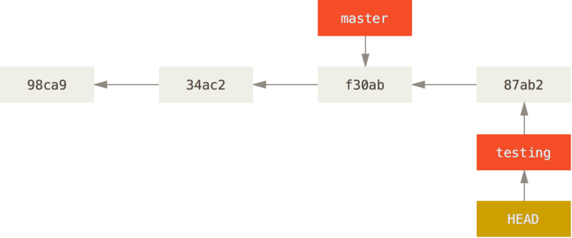
Branches
What is a Branch?
Branching allows for multiple development streams within the same repo.
Here we have two branches, master and testing.
https://git-scm.com/book/en/v2/Git-Branching-Branches-in-a-Nutshell

Slide 36
Renaming Branches
Use the -m flag to rename a branch:
$ git branch -m <old-name> <new-name>
The term "master" has traditionally been used in Git to refer to the default branch in a repository. (like a 'master copy') However, there has been a significant shift in the industry to move away from the term "master" due to its negative connotations, particularly its association with slavery.
If your default branch is called 'master' please change it like so.
$ git branch -m master main

Slide 37
Creating and Switching
Create a new branch:
$ git branch <new-branch-name>
Switch to a branch:
$ git switch <existing-branch-name>
Both at once:
$ git switch -c <new-branch-name>

Slide 38
Combining Branches
Merging changes:
Start on the branch that you want to merge changes into by switching to it.
$ git switch <branch-with-NO-changes>
Then merge in the branch that has the changes.
$ git merge <branch-WITH-changes>

Slide 39
Deleting Branches
After merging branches, you may want to clean up your repo by deleting them.
To delete a branch safely:
$ git branch -d <branch-to delete>
Use a capital D flag for unsafe deletion. (Does not check for unmerged changes!)
$ git branch -D <branch-to-force-delete>
To delete remote branches that no longer exist:
$ git fetch --prune

Slide 40
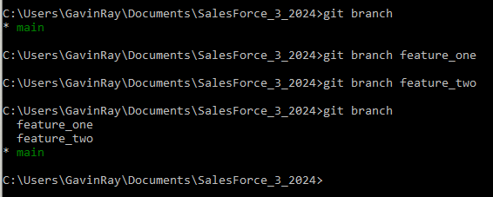
Second Activity: Branches
Practice making 2 branches off of main (master).
Using the commands from the previous slides, create 2 new branches and switch to it. You can check the names of your branches with:
$ git branch
Only proceed to the next part if you see three branches.

Slide 41
Second Activity: Branches
Choose a file to edit on both branches.
Switch to each branch in turn, and edit the exact same line in the exact same file in both branches.
Use your IDE to do this.
Switch to first branch
Make edit.
Add and commit.
Switch to second branch.
Make a different edit in the same exact spot.
Add and commit.

Slide 42
Second Activity: Branches
Update your main branch through merging.
Switch back to the main branch , and merge in both of the branches one at a time.
$ git switch main
$ git merge <branch-one>
$ git merge <branch-two>

Slide 43
Second Activity: Oops!
You have a merge conflict!
Automatic merge failed; fix conflicts and then commit the result.
If you try to merge in conflicting changes, git does not know which merge to use.

Slide 44

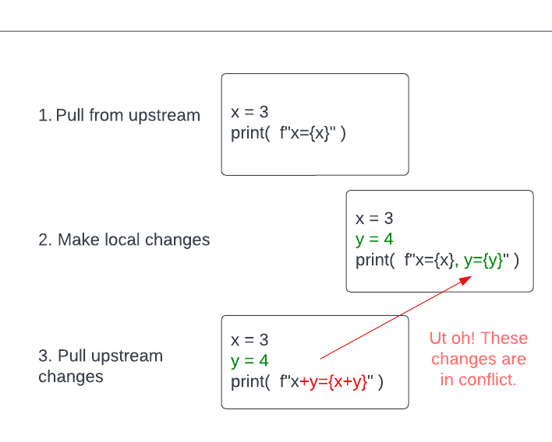
Merge Conflicts (Oh merow!)
How conflicts arise, fixing conflicts, stashing as a way to avoid conflicts.
Conflicts occur when Git is given two changes, and it doesn't know which one to accept.

Slide 45
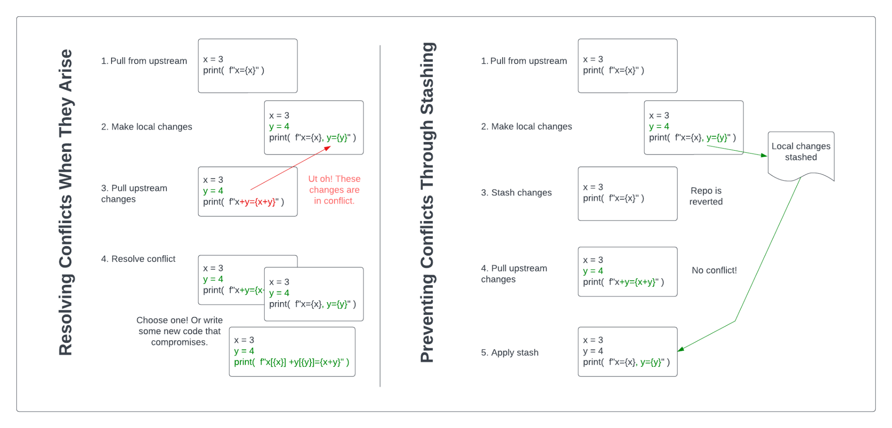

Slide 46
Second Activity: Branches
Resolving a conflict:
When Git encounters a conflict, it will merge as much as it can, and then pause the merge.
Git then marks the areas of conflict in the files by adding both streams of development. It is up to you to go in and choose what changes to keep. This will look different depending on your IDE.
Once you have made your choice, add and commit the files again to complete the merge.

Slide 47
Deleting Branches
After merging branches, you may want to clean up your repo by deleting them.
To delete a branch safely:
$ git branch -d <branch-to delete>
Use a capital D flag for unsafe deletion. (Does not check for unmerged changes!)
$ git branch -D <branch-to-force-delete>
To delete remote branches that no longer exist:
$ git fetch --prune

Slide 48
Group Discussion: Logs and Histories
Git Status is only the beginning:
Try out these other commands.
$ git log flags: --oneline --graph --decorate --all
$ git show <commit hash> (hash is optional)
$ git diff --staged or <commit1> <commit2>
Be ready to discuss what you noticed with the group.

Slide 49
Tags
A tag points to a specific commit.
Create a tag on the current commit:
$ git tag <tagname>
Tags can be annotated with extra information.
$ git tag -a <tagname> -m "<message>"
You can checkout or create new branches from tags!
$ git checkout <tagname>
$ git switch -c <new-branch-name> <tagname>

Slide 50
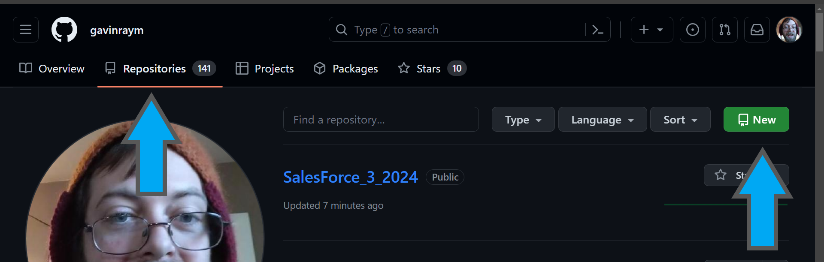
Remotes
What is a Remote?
Remotes are versions of a project that are hosted on the internet. Go to Github create your own remote repository with the green New button.

Slide 51
Remotes
Adding a remote:
Add your new remote repo to your project as the origin.
$ git remote add origin [your-remote-url]
Note: you can name remotes whatever you want. Origin is just a common name used for the main remote that you want set as the source, or main remote.
Git will use the name 'origin' by default when cloning a repo, so let's stick with it for now.

Slide 52
Remotes
How do I know that worked?
Check your remotes with the following commands.
$ git remote
$ git remote -v
You may have noticed that you can have a different url for pushing. Set it like this:
$ git remote set-url –push origin <url>

Slide 53
Remotes
Adding my files to the remote:
Once your remote is set up, you can push your files to it.
$ git push <remote> <branch>
You should now see your files in your Github repo. You also can set auto-push/pull-remotes with the following command:
$ git push --set-upstream <remote> <branch>
This allows you to run git push without the remote name argument.

Slide 54
Adding Remotes
You can have as many remotes as you want.
Use the same command as before, but with different remote names.
$ git remote add [remote-name] [remote-url]

Slide 55
Third Activity: A Common Github Workflow
Working with forks:
On Github, fork the course repo from:
https://github.com/gavinraym/SalesForce_3_2024
Then, in a new terminal, clone your fork with:
$ git clone <your-fork-url>
Cloning will create a new directory with the repo files inside it. Feel free to rename the root level directory.

Slide 56
Third Activity: A Common Github Workflow
Creating a feature branch:
Select a team leader for your room. That person will create a branch that everyone in the room will pull from.
https://github.com/gavinraym/SalesForce_3_2024
Everyone else, set the team leads repo as a remote.
git remote add <remote-name> <teamLead-url>
And switch to the branch they created for your team.

Slide 57
Third Activity: A Common Github Workflow
Adding your own changes:
Team leads will now add a section to the roster.txt file that will be for your team. Create a team name, and add your name on the first line after the team name. I have added myself to the file under 'Team Instruction' for reference.
Team leads will then commit and push the change.

Slide 58
Third Activity: A Common Github Workflow
Acquiring the team lead's branch:
Because the team lead's branch does not exist on everyone else's local machines, it must be pulled.
$ git pull <remote-name> <branch-name>
You can then switch to the new branch.
$ git switch <branch-name>

Slide 59
Third Activity: A Common Github Workflow
Team members, your turn.
Team members will now add their names to the file.
Each member will:
Add their name to the file.
Git add, commit.
Git push, wish moves the changes to their fork.
Submit a PR on Github

Slide 60
Third Activity: A Common Github Workflow
Merge conflicts galore!
Team leads can only merge in one PR before creating a merge conflict. Everyone else will have to update their files first, and then re-submit.
This will start a long chain of processing merge conflicts. Embrace the chaos! I promise, it will all be over soon.

Slide 61
Third Activity: A Common Github Workflow
Embrace the chaos!
Team members who were NOT merged:
Pull from remote.
Resolve conflict.
Push and submit new PR.
Team members who WERE merged:
Do nothing for now.

Slide 62
Third Activity: A Common Github Workflow
Team leads, your turn.
Team leads will now merge their branches with the main branch, and submit PRs to the origin. I will direct this process.
Nice work, everyone!

Slide 63
Stashing
Shelves your current changes temporarily.
Git will remove all modifications from the working directory, and save them on a stack of unfinished changes. The working directory is reverted back to the last commit.
$ git stash Moves modifications to the stash stack.
$ git stash apply Applies without removing stash from stack.
$ git stash pop Applies and removes stash from stack.
$ git stash drop Removes the top stash without applying it.

Slide 64
Cherry Picking
You can select and apply individual commits across branches using the commit hash or tag.
First, checkout the branch you want to apply the cherry picked commit to. Then run the command:
$ git cherry-pick <tag-or-hash>
The indicated commit will be applied to the branch.

Slide 65
Hooks
Scripts can be executed before and after events.
There are two types of hooks, client side and server side. All hooks can be set up to run automatically when an event occurs. Events include:
Pre-commit, runs before the commit is saved.
Commit-msg, runs after the commit message is written.
Post-Commit, runs after the commit is made.
Pre and post-receive, server side hooks.
Pre-merge-commit, runs before merging.

Slide 66
Hooks
Hooks are scripts.
The script name should match the event. So, a pre-commit hook should have the address:
your-repo/.git/hooks
The files must be a shell or batch file marked as executable.
$ chmod +x pre-commit

Slide 67
Automated Build Systems
Continuous integration, continuous deployment.
Integrating Git with a build systems automates the process of compiling, testing, and deploying code changes. The benefits include:
Immediate detection of issues
Faster resolution times
Automatic testing and deployment
Streamlining the development process

Slide 68
Automated Build Systems
Brief introduction to Jenkins.
Jenkins is an open-source automation server that automates tasks related to building, testing, delivering, and deploying software.
Supports multiple languages
Plugins can be used to extend functionality.
Great for complex build pipelines.
Uses a Groovy-based domain specific language file to allow a 'Pipeline as Code' approach.
Jenkinsfile examples: https://www.jenkins.io/doc/pipeline/examples/

Slide 69
IDE integration, and Github Desktop
Every IDE is different, but most can use Git.
Look for a plugin that will allow file tracking right within your IDE. Some will even help with committing or other functions, so that you don't have to remember the commands or use a terminal.
Github Desktop is a great UI.
It bypasses the need for terminal commands, helps with visualizing the repo history, and even manages your security (no more

Slide 70
Extras…
Pruning, cherry picking, hooks
$git prune or $git gc
Deletes temporary files.
gc (garbage collection) also runs prune.
Very safe; will not affect repo.
$git cherry-pick [commit hash]
Adds commit from another branch.
Like merge, but only for one commit instead of a whole branch.
Hooks!
Hooks are scripts that you can add to your workflow.
Hooks are run automatically at specific times, for example: pre-commit, post-commit, rpe-push, etc.

Slide 71
Please complete the End Of Class survey!
https://sfdc.plusplus.app/login/?next=/a/surveys/2238/
And thanks so much for being a part of our class!

Slide 72

Thank you!
If you have any additional questions, please ask!If
Notes:
Mandatory -- Need bookend -- first and last thing they should see is Pluralsight.
ACTION: Use this for the final slide of your class materials. Include contact information so participants can reach you if they have questions after the course.

